Slide 1
My personal commerce account banking application
Group 7
mariam habib | scott howard | irem atik | grant Jenkins | Maryam Albakhiet

Slide 2
Project overview
The My Personal Commerce Account Banking application is a web application available to anyone who has access to the internet. It allows users to create and link their accounts that is associated with their Commerce Bank checking or savings account. It provides customers with an online system that pulls in transaction details in the Dashboard and allows users to set triggers for notification rules for user activity, balance amount, and transaction amount. These triggers will activate notifications to the user via text or email. Other features include the “Forgot Password” feature and “Remember Me” feature. The user can click Forgot Password, enter the email associated with their account, and receive a link to reset their password. The Remember Me functions allows the computer to store the user’s login information, allowing them to skip the login process when returning to the web application. The system saves the data to a database so recurring reports can be created.

Slide 3
Technology platform
The My Personal Commerce Account Banking Application is designed to work on modern browsers for customers with Commerce Bank accounts.
It was developed using Python Django Web Framework.
The web application interfaces with SQL Server as the relational database management system.
It can be used on Windows, Mac OS, and Linux systems.

Slide 4
Login page
The login page is first page a user sees when they enter the website. It includes a Username and Password field. It also allows the user to click and utilize the “Remember Me” function. If the user does not remember their password, they can click “Forgot Password” and follow the process. Or if the user is new, they can click “Activate your online banking account” to create an account.

Slide 5
dashboard
When the user logs into their account, they are taken to their Dashboard. It shows the number of times notification rules have been triggered over the past month and/or year. It also shows the account balance for the past year.

Slide 6
Set up notifications
We implemented three types of triggers in the Set Up Notifications page.
The first trigger allows users to set notifications for user activity. They can be notified by phone or email when the user logs in from any device or when there is any changes made to the account.
The second trigger allows users to set a notification for when their account balance reaches a certain number. They can choose an amount greater than, equal to, or less than an amount. They can choose which account balance to set notifications for. They can be notified by phone or email.
The third trigger allows users to set a notification for when a single transaction amount reaches a certain number. They can choose an amount greater than or equal to an amount. They can choose which account’s transactions balance to set notifications for. They can be notified by phone or email.

Slide 7
notifications
The Notifications page shows what type of activity was done along with a message specifying what notification was triggered, and the time and date it occurred. Users have the ability to mark their notifications as read, so they do not show up anymore. They can also delete the notifications to clear the screen.

Slide 8
accounts
Users can add new accounts using their account number and associate it with a Checking or Savings account. They can view their accounts transactions. This will include the date, time, description of the transaction, amount of the transaction, and the total balance of their account. They can add transactions and also have the ability export their transactions to a spreadsheet.

Slide 9
User profile
The User Profile page allows users to view and update their information such as their username, first name, last name, email, and phone number that is associated with their account. They can also change their password within this page.

Slide 10
Stretch goals
We used Commerce Bank color scheme in styling our web application.
We added the “Remember Me” function
We added the “Forgot Username” function
We allowed users to receive notifications via email and/or text

Slide 11
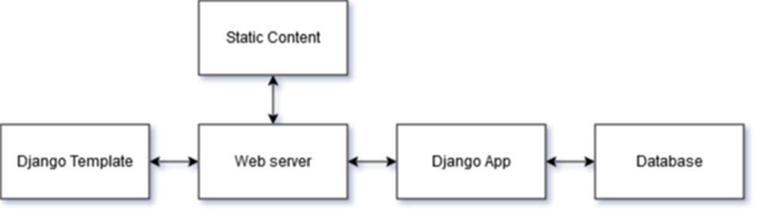
Logical view

Slide 12
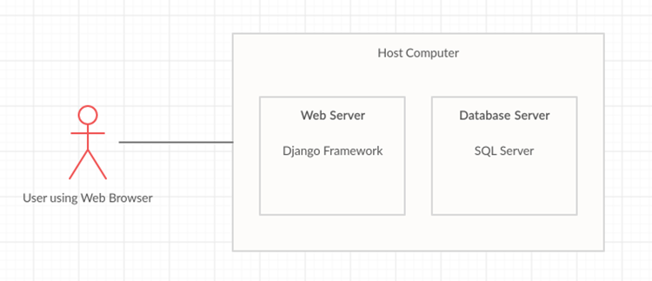
Physical view

Slide 13
documentation
This project was divided into five iterations. At the end of each iteration, the completed work was reviewed, and the remaining work was analyzed to determine the goals, objectives, and deliverables for the next iteration. The following is all the documentation that was completed.
Project Charter
Requirements Document
Project Plan
Risk Management Report
Architecture Document
User Guide
System Guide
Test Plan
Test Specifications
Test Reports

